Slide 1
Bioinformatics with real example

Slide 2
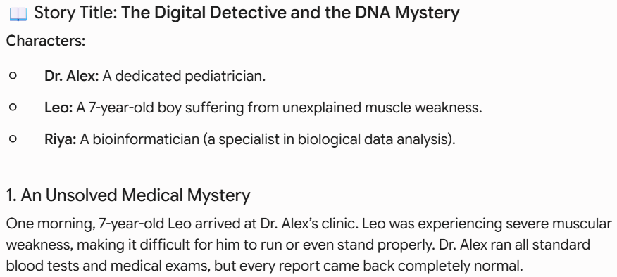

Slide 3
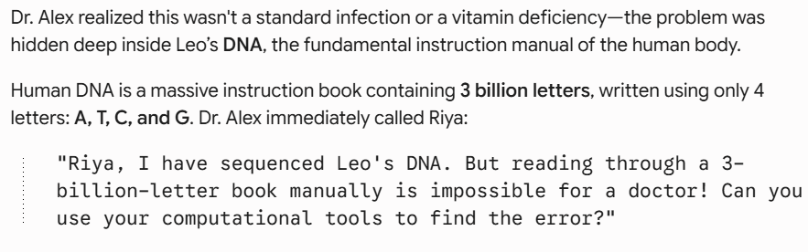

Slide 4
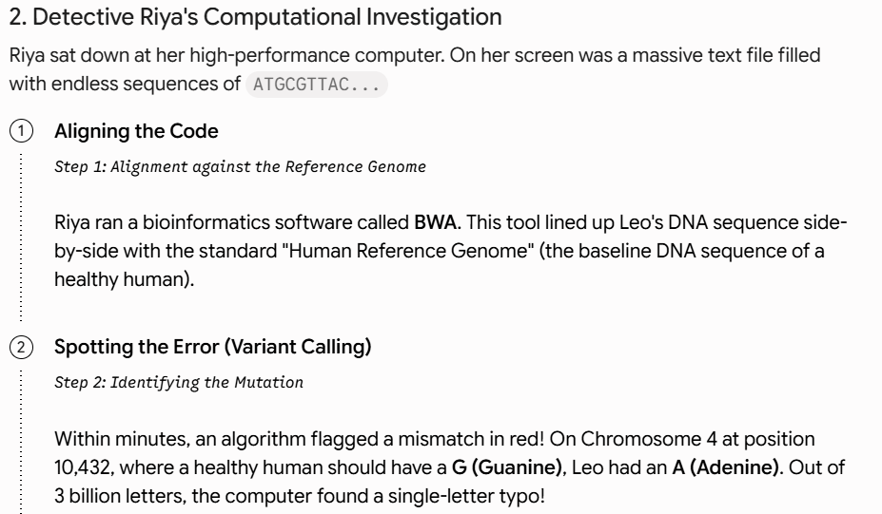

Slide 5
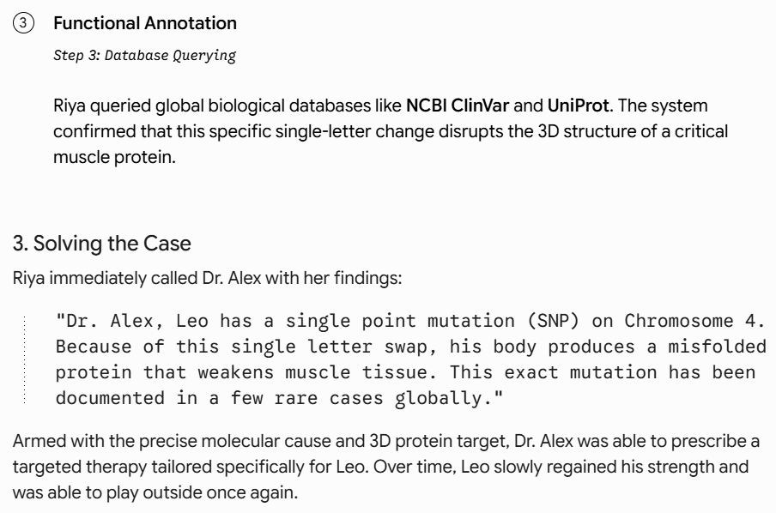

Slide 6
Story Element | Bioinformatics Term | Real-World Concept
3-Billion-Letter DNA Book | Genomic Data | The total set of genetic instructions in an organism.
Digital Search Tools | Bioinformatics Software | Fast computer algorithms designed to scan billions of data points.
Finding the Single Typo | Variant Calling / SNP Identification | Identifying mutations or genetic variations that cause disease.
Global Reference Repositories | Biological Databases (NCBI, UniProt) | Public repositories storing genetic and protein structure data submitted worldwide.

Slide 7
Bioinformatics with real example
Bioinformatics is the interdisciplinary field that combines biology, computer science, mathematics, and statistics to analyze and interpret biological data—especially large and complex datasets like DNA, RNA, and protein sequences.

Slide 8
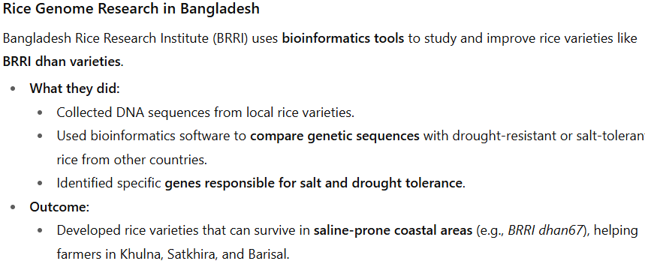
Bangladesh-specific real example of bioinformatics

Slide 9
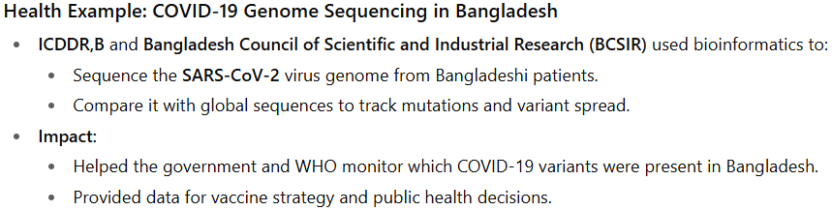
Bangladesh-specific real example of bioinformatics

